Slide 1

Daily recap
DATA ANALYTICS | IRONHACK

Slide 2


IRONHACK BOOTCAMP
TYPES OF
DATA ANALYSIS
Descriptive
Diagnostic
Predictive
Prescriptive
Summarize existing data to get a picture of what has happened or is happening
Uncovering the root cause of events
Forecast possibilities in the future
Analyzing and recommending the best actions

Slide 3
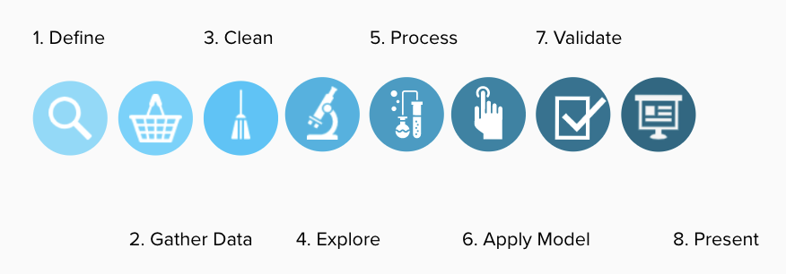
DATA ANALYTICS
DATA ANALYSIS PROCESS

Slide 4
IRONHACK BOOTCAMP
POPULATIONS AND SAMPLES
A population is a COMPLETE collection of items/individuals/products
A sample is SUBSET of a population
Population
Sample

Slide 5
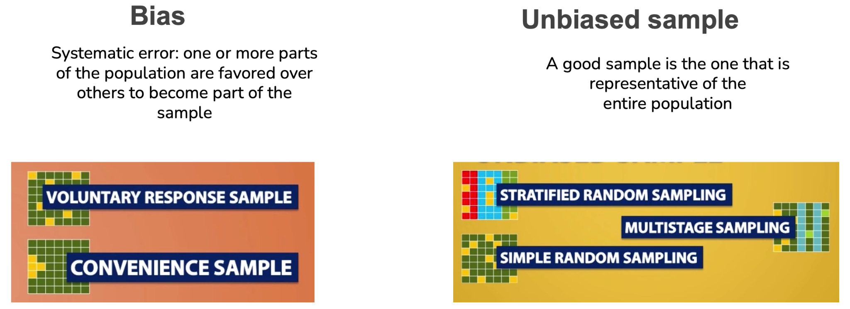
IRONHACK BOOTCAMP
SAMPLING METHODS

Slide 6
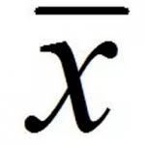
IRONHACK BOOTCAMP
COMMON STATISTICS NOTATION
POPULATION PARAMETERS:
N: Number of elements in the population
μ: mean of the population
𝜎: standard deviation of the population
SAMPLE STATISTICS: ( they are random by nature they change from sample to sample )
n: Number of elements in the sample
: : sample mean
S: sample standard deviation

Slide 7
IRONHACK BOOTCAMP
MEASURES OF DISPERSION
Residuals: ( real - predicted )
Variance: sum of squared residuals divided by n - 1
Standard deviation: root square of variance
Range: difference between the maximum and minimum
Percentile: the value such P percent takes this value or less
Interquartile range: difference between percentiles 75% and 25%

Slide 8
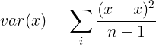
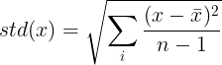
IRONHACK BOOTCAMP
VARIANCE AND STANDARD DEVIATION
Variance:
Standard deviation:
(we divide by n-1 to
avoid underestimating the
Standard deviation)
demo

Slide 9
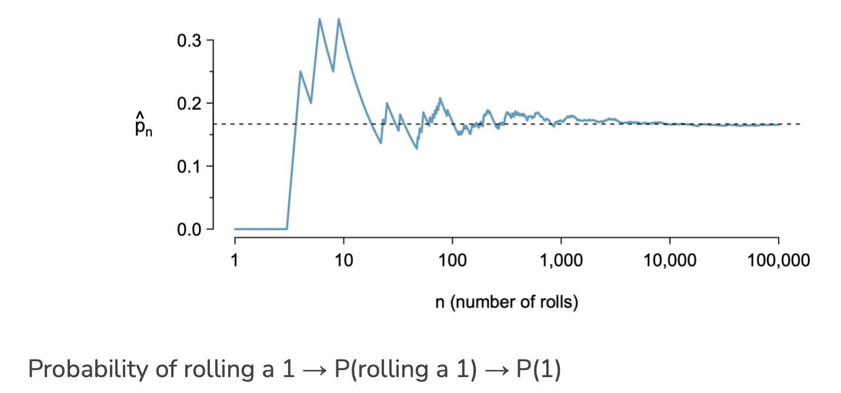
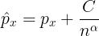
IRONHACK BOOTCAMP
EVENTS AND PROBABILITY
The probability of an outcome is the proportion of times that the outcome will occur if we observe the random process an infinite amount of times

Slide 10
IRONHACK BOOTCAMP
COMBINING PROBABILITIES: JOINT EVENTS
To compute the probability of two joint events, we add the probabilities of each of them but subtracting the intersections:

Slide 11

IRONHACK BOOTCAMP
PROBABILITIES IN PYTHON: SCIPY
Scipy library contains the module ‘stats’ which allows you to compute probabilities, PDF, CDF,....for several distributions.
Official documentation
scipy.stats.norm.pmf()
scipy.stats.expon.pmf()
…
Every distribution has his own pmf() function in scipy.

Slide 12


